Slide 1
Why Excel?
RX 319
Introduction to Healthcare Analytics

Slide 2
Learning Objectives
Describe the key functions of Excel
Explain how Excel can be useful to healthcare professionals.
2

Slide 3
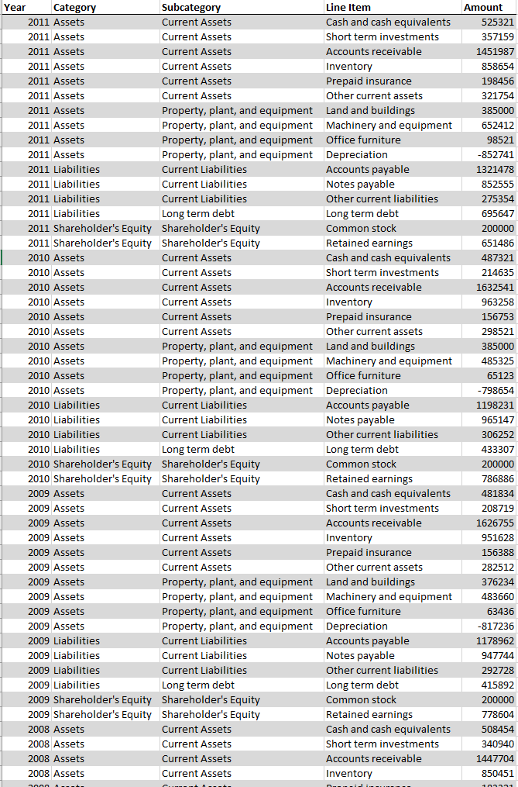
Ok, grab your calculator…
We can answer simple questions with a query and a calculator
Pharmacists need to do other calculations, too
Dosage calculations
Fraud detection
Financial calculations
Do you really want to type all those numbers in a calculator?

Slide 4
Put down your calculator
Excel lets us do more
Organize and explore data
Summarize data
Data visualization
Statistical analysis
Query data
Export data
Open in Excel
Analyze
4

